Slide 1
USA Staffing Applicant Documentation Command Brief
Operations Department
Office of Civilian Human Resources
May 2019

Slide 2
BLUF
01 July 2019, all applicants, including current DON employees, applying to DON positions must submit documentation that supports their eligibility and qualifications at the time of application
Eligibility will be determined PRIOR to referral to the hiring manager
Applicants who do not provide all of the supporting documentation necessary to verify appointment eligibility, promotion eligibility, and qualifications will not be referred

Slide 3
Agenda
Reason for the change
Applicant certification
Current DON applicant documentation process
New DON applicant documentation process
Instructions for submitting documentation
Review

Slide 4
Reason for the Change
This change is the result of customer input and a successfully pilot. It will:
Increase the quality of our certificates
Standardize application procedures for all DON vacancy announcements
Align DON with the application processes of other DoD and Federal agencies
Reduce the wait time for tentative job offers

Slide 5
Applicant Certification
Applicants to DON Job Opportunity Announcements must answer questions to make claims regarding their appointment or promotion eligibility, and qualifications
Applicant claims must be verified by an HR Specialist before referral to the hiring manager
Verification requires review of appointment or promotion eligibility and qualifications documentation

Slide 6
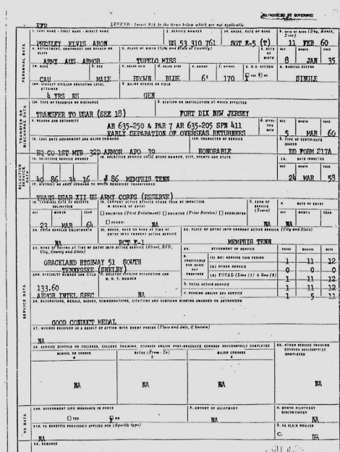
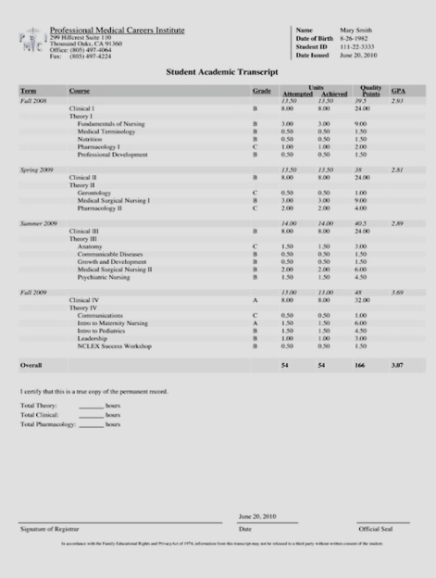
Current Documentation Process
On internal recruitments, i.e. status candidates, the HR Specialist uses the content of the resume to verify applicant claims
On external recruitments, i.e. public candidates, the HR Specialist requires supporting documentation (e.g. DD-214, Transcripts, etc.) to verify applicant claims

Slide 7
PILOT Documentation Process
DONAA piloted an “early eligibility” process. Both internal and external recruitments required supporting documentation (e.g. DD-214, Transcripts, etc.) to verify applicant claims
Hiring Managers had greater confidence that candidates were eligible
Overall percentage of ineligibles was not significantly impacted

Slide 8
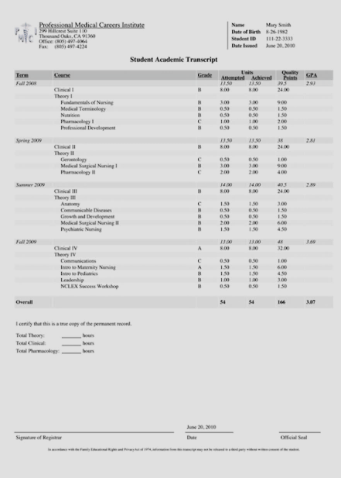
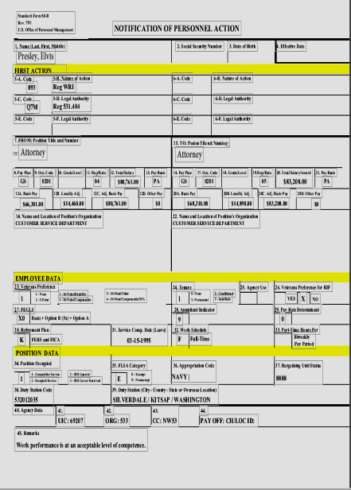
New Documentation Process
All DON internal and external recruitments will have the same documentation process
Status candidates (including DON employees) must submit supporting documentation (e.g. SF-50(s), Transcripts, etc.) to support the claims made in the application and prove promotion eligibility (time in grade)

Slide 9
The Correct SF-50
SF-50s are used to verify the applicant’s appointment eligibility (or area of consideration) AND promotion eligibility
The most recent SF-50 will prove eligibility (area of consideration)
The most recent SF-50 will rarely prove promotion eligibility (time in grade)
Applicants should submit their most recent SF-50 AND another SF-50 that is dated more than one year ago. In most cases, we need to see two (2) SF-50s to determine time-in-grade and eligibility for promotion.

Slide 10
DON employees need to know
All applicants, including current DON employees, must submit documents at time of application
Documents are required to prove: appointment eligibility, promotion eligibility, and qualifications
If the position requires education, unofficial transcripts are usually required, but when specific coursework does not need to be verified, a copy of the degree is acceptable. The announcement will include this information.
Unofficial transcripts are free and can be printed from the student portal of the college website. If you encounter difficulty using the school’s student portal, call the school’s registrar office
You may be able to copy your transcripts from your eOPF
DON employees can obtain copies of their SF-50s from MyBiz+.
OCHR requests applicants submit two SF-50s. The SF-50 that supports your appointment eligibility will rarely support your promotion eligibility.
Documents loaded to USAJOBS once can be re-used
HR Specialists at the OCHR Operations Centers will not change an applicant's answer to a question, even upon request
OCHR Operations Centers will not accept documents after the closing date of the announcement It is the responsibility of the applicant to make sure the documents submitted are the correct documents

Slide 11
Documentation Requirements
Announcement Text
Application
General documentation requirements are located in the Required Documents section of the Announcement Text
Specific documentation requirements are listed for each eligibility in the Eligibilities section of the Application.

Slide 12
Required Documents
Not all required documents will be marked required. Only documents required of all applicants are marked required. Document requirements that vary by type of applicant (i.e., DD-214 or SF-50) will not say required, but you must submit the document that applies to you.

Slide 13
Submitting Documents
Click the dropdown box next to every accepted document type that applies to you and select your document to submit it. Documents not assigned to an accepted document type will NOT be submitted with the application

Slide 14
Adding New Documents
If you are missing a required document in the drop down, you can upload it at the bottom of the page and it is immediately available in the dropdown.

Slide 15
Unassigned Documents
If there are any documents in your account that were not assigned to an accepted document type, you will get a pop up warning. Review carefully! The documents listed in the pop up will NOT be submitted as part of your application.

Slide 16
Missing Required Documents
If you do not submit a document marked required, you will not be able to submit your application

Slide 17
Missing Required Documents
You must have all green check marks to apply

Slide 18
Review
01 July 2019, all applicants, including current DON employees, applying to DON positions must submit documentation that supports applicant eligibility and qualifications at the time of application
Eligibility will be determined PRIOR to referral to the hiring manager
Applicants who do not provide supporting documentation, or provide documentation that does not support their claims, will not be referred

Slide 19
Questions
dawn.fish@navy.mil

